Slide 1


PRODUCT ANALYTICS FOR MeWe
Your Data, Your Rules
Presented By –Jaya Dev Sahoo

Slide 2

What Is MeWe?
MeWe is a next-generation privacy-first social network designed to help people connect and communicate without surveillance, ads, or algorithmic manipulation.Unlike conventional platforms that exploit user data for engagement metrics, MeWe prioritizes authentic interaction, trust, and control.The app offers tools for sharing posts, photos, and messages within trusted circles—fostering a safe, ad-free environment for real conversations and meaningful relationships.
Problem Statement
Most social media platforms today optimize for advertising revenue and screen time, leading to privacy erosion, misinformation, and shallow engagement.Users feel increasingly watched, manipulated, and fatigued by algorithm-driven feeds.There is a strong need for a transparent, community-based social platform that promotes authentic communication and empowers users to own their data—free from corporate interference.

Slide 3
MeWe’s Core Feature
Feature | Description
Ad-Free Feed | Pure, chronological posts—no data mining or ad tracking.
Privacy Controls | Advanced permissions for posts, chats, and groups.
Encrypted Messaging | Secure, end-to-end encrypted communication between users.
Customizable Groups | Community hubs for shared interests with moderation tools.
Cloud Storage Integration | 8GB of private storage for photos and files.
No Algorithms | User feeds are chronological, ensuring authentic content visibility.
Community Engagement Tools | Features for polls, group events, and shared discussions.

Slide 4
MARKET OPPORTUNITY
With privacy concerns and data misuse scandals rising globally, users are turning toward ethical, non-surveillance-based platforms like MeWe.
Key metrics
Market Size
Global social media market revenue is large (hundreds of billions, with estimates around $307–$341 billion in 2025), highlighting significant revenue opportunity for new platforms.
CAGR (Growth Rate)
The industry is projected to grow at a healthy CAGR of approximately 13%–17% through 2030, indicating sustained expansion.
Global Active Users
Over 5.4 billion people are active on social media globally, representing about two‑thirds of the world’s population.
Average Time Spent
Users spend ~140 minutes per day on social platforms, reflecting strong engagement opportunities.
Mobile Access
Over 90% of social media users access platforms via smartphones—MeWe is fully mobile-optimized.
Ad Revenue Direction
While ad-driven models dominate, MeWe’s subscription and freemium model taps into the rising demand for ad-free experiences.

Slide 5
USER BEHAVIOUR TRENDS
Observed Behaviour | Data Point / Insight | Implication for MeWe
Privacy-first mindset | 74% of users worry about online data misuse | Reinforce trust through transparency and encryption
Desire for ad-free experience | Over 60% of users install ad blockers | MeWe’s no-ad promise becomes its core USP
Shift toward meaningful connections | Users prefer close-group interactions over public posts | Focus on private groups and small communities
Fatigue from algorithmic feeds | 68% of users distrust algorithm-based suggestions | Maintain chronological, user-controlled feed
Increasing mobile dependency | 90%+ users access social platforms via mobile | Prioritize intuitive mobile UX
Growth of ethical tech | Rising adoption of privacy apps and messengers | Position MeWe as a leader in “ethical social networking”
Subscription acceptance | Freemium models gaining popularity | Monetize ethically through premium cloud features

Slide 6
MARKET BENCHMARKING AND STRATEGIC FIT
2026 Trend | Key Insight | Strategic Fit for MeWe
Privacy and security revolution | Data leaks drive user migration | MeWe’s encrypted, ad-free platform fits perfectly
Rise of decentralized social media | Users seek control and autonomy | MeWe’s privacy-driven architecture aligns with user expectations
Trust as a brand currency | Ethical platforms outperform ad-driven ones | MeWe builds brand loyalty through transparency
Subscription economy growth | Users willing to pay for privacy | MeWe monetizes ethically via premium upgrades
Mental health awareness | Users seek less-toxic social environments | Ad-free design supports digital well-being

Slide 7
TARGET AUDIENCE SEGMENTATION
Segment | Profile & Behavior | What They Drive
Primary: Privacy Advocates (25–40) | Tech-aware users valuing data protection and ad-free experiences | Premium subscription growth
Secondary: Conscious Professionals (30–45) | Working individuals seeking distraction-free social circles | Retention and trust
Tertiary: Digital Minimalists (18–30) | Gen Z and Millennials leaving algorithm-heavy apps | Organic adoption and engagement depth

Slide 8
What is the HEART Framework ?
The HEART Framework is a user-centered model measuring product success across Happiness, Engagement, Adoption, Retention, and Task Success, combining behavioral data and user experience to evaluate satisfaction and long-term value.
Why heart works for MeWe
The HEART framework works for MeWe because it measures authentic engagement, user trust, and satisfaction without relying on ads or algorithms. It aligns with MeWe’s privacy-first vision, balancing behavioral insights with emotional value to improve long-term retention and experience.

Slide 9
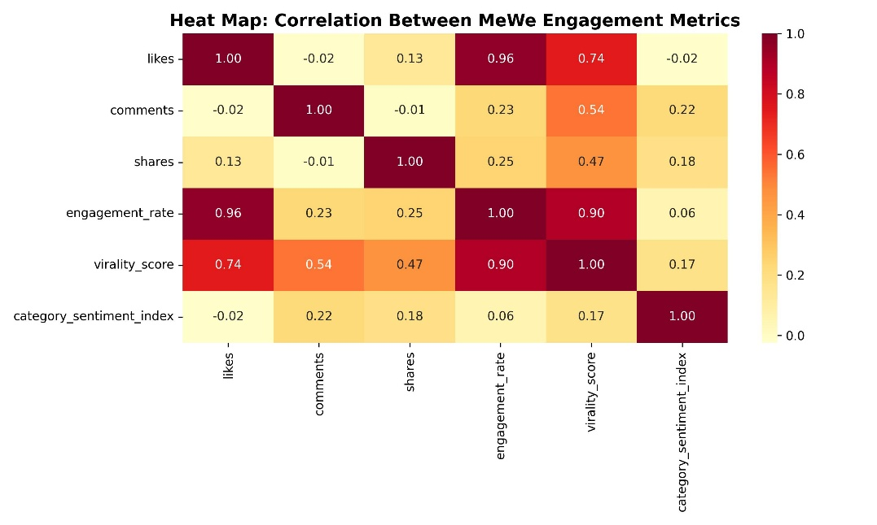
HEAT MAP
Insights from the Heat Map:
Engagement Rate strongly correlates with likes and shares, indicating that user activity scales with interactive actions rather than passive views.
Virality Score is positively tied to shares and comments, meaning posts with higher discussion rates spread faster.
Category Sentiment Index shows mild correlation with engagement rate, suggesting emotional tone influences interaction quality.
Likes and comments move together moderately, showing balanced engagement across reactions and discussions.

Slide 10
HEART FRAMEWORK FOR MeWe
Aspect | Goal | Signals | Metrics | Why It Matters
H – Happiness | Build trust and satisfaction | Positive reviews, repeat visits | NPS ≥ 60, CSAT ≥ 75% | Reflects user confidence in privacy & control
E – Engagement | Encourage active, authentic use | Posts, shares, group messages | DEU ≥ 25%, 2+ actions/day | Measures meaningful participation
A – Adoption | Smooth onboarding & first use | Account creation, first post | Day-1 activation ≥ 45% | Early engagement predicts loyalty
R – Retention | Sustain user relationships | D7 & D30 repeat activity | D7 ≥ 20%, D30 ≥ 15% | Ensures ongoing satisfaction & trust
T – Task Success | Ensure frictionless UX | Successful post/share rate | ≥ 90% success rate | Indicates platform usability and reliability

Slide 11
Core reasons for using HEART
Aligns with MeWe’s Privacy-First and User-Centric Vision:HEART focuses on user satisfaction and engagement quality, not vanity metrics.This aligns perfectly with MeWe’s mission to build trust, authenticity, and meaningful communication instead of chasing screen time or ads.
Balances Quantitative Data with Emotional Insight:HEART combines behavioral metrics (likes, shares, comments) with sentiment and satisfaction data, helping MeWe measure both what users do and how they feel — critical for a privacy-driven platform.
Tracks Long-Term Value Over Short-Term Reach:Unlike traditional KPIs, HEART emphasizes retention, happiness, and repeat engagement, ensuring MeWe grows sustainably by deepening user relationships, not just increasing sign-ups.
Supports Early Product Evaluation and Improvement:By mapping engagement, adoption, and task success, MeWe can quickly identify UX friction, improve onboarding, and enhance user experience — all while maintaining its ad-free ethical model.

Slide 12
NORTH STAR METRIC
North Star Metric: Daily Engaged Users (DEU)
Definition: Unique users performing at least one meaningful, privacy-respecting interaction (post, comment, group share, or message) per day.
Why It Matters:
DEU represents active participation and trust, not passive presence.
It connects daily engagement quality with long-term retention and subscription growth.
Supporting Sub-Metrics:
Engagement rate (active vs. total users)
Avg. group participation per day
Engagement mix (posts, chats, shares)
Subscription conversion ratio

Slide 13
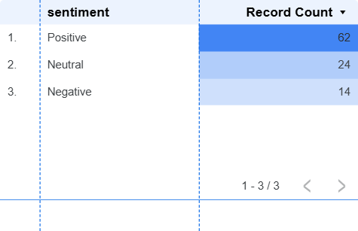
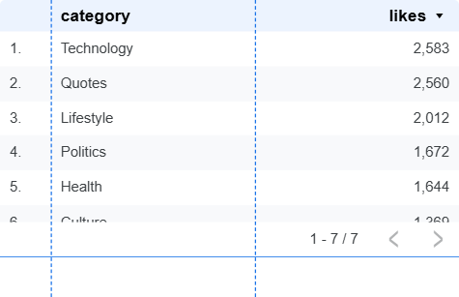
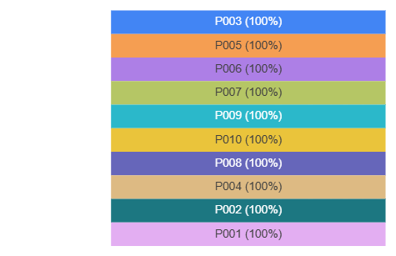
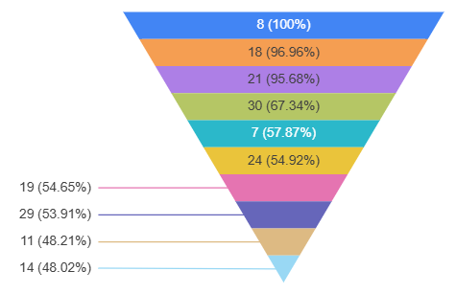
DASHBOARD
Dataset Link: https://docs.google.com/spreadsheets/d/1NBTwTr40B2iOy1D6f_aHZtjxhVBtUkWXo5ImQN58pzU/edit?usp=sharing

Slide 14
KEY INSIGHTS AND STRATEGIC DIRECTION
Activation quality and early engagement depth predict long-term retention.
Users who interact with 3+ features in their first week are 2× more likely to return.
Privacy-first transparency improves trust and brand perception, especially among professionals.
AI-assisted personalization increases relevance while preventing content fatigue.
Focus Mode and Community Circles promote healthy engagement and sustained connections.

Slide 15
STRATEGIC FOCUS GOING FORWARD
Enhance onboarding to highlight privacy features.
Integrate community-led discovery and collaborative group tools.
Use transparent communication to reinforce brand credibility.
Promote MeWe as the ethical, user-controlled evolution of social networking.
Expand into localized communities and professional groups for retention growth.

Slide 16
THANK YOU……!

